Slide 1
Chapter Quiz
Coding and Programming

Slide 2
Quiz
Chapter 5
For Student
ⓒ2023 SAMSUNG. All rights reserved.
Samsung Electronics Corporate Citizenship Office holds the copyright of this document.
This document is a literary property protected by copyright law so reprint and reproduction without permission are prohibited.
To use this document other than the curriculum of Samsung innovation Campus, you must receive written consent from copyright holder.

Slide 3
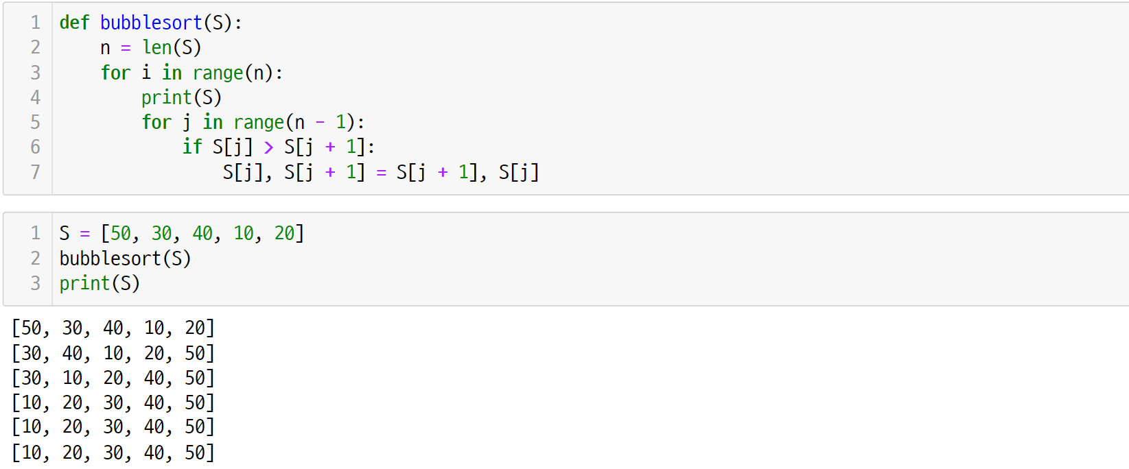
UNIT 27
Bubble, Selection, and Insertion Sort
Q. 27-01
How many swaps were executed in the bubble sort process below?

Slide 4
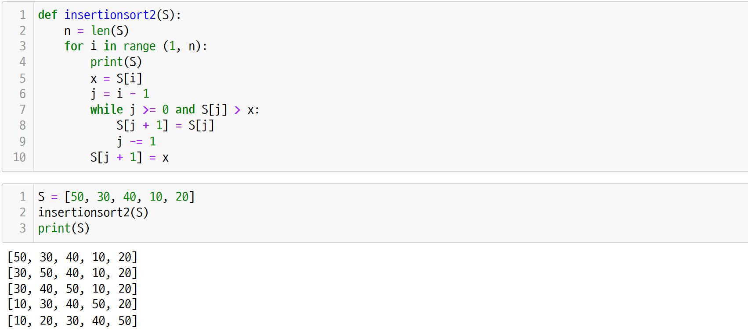
UNIT 27
Bubble, Selection, and Insertion Sort
Q. 27-02
How many comparisons were executed in the insertion sort process below?

Slide 5
UNIT 28
Merge Sort
Q. 28-01
How many times was the merge2() function executed in the merge sort process below?

Slide 6
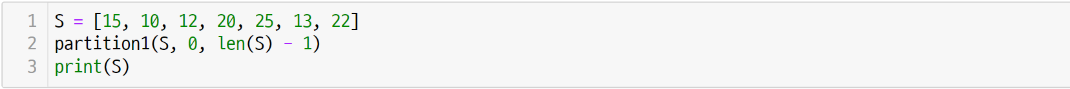
UNIT 29
Quick Sort
Q. 29-01
Given the list below, write the output after executing the partition1() function.

